Slide 1
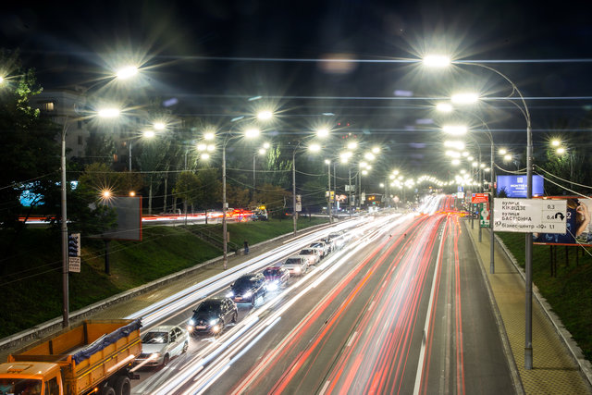
Automatic Night Lamp using a Transistor
WELCOME
Page -1

Slide 2
Outline
Introduction
Defination of Automatic Night Light
Need
Material
Procedure
Observation
Advantages
Application
Limitation
Conclusion
Page – 4

Slide 3
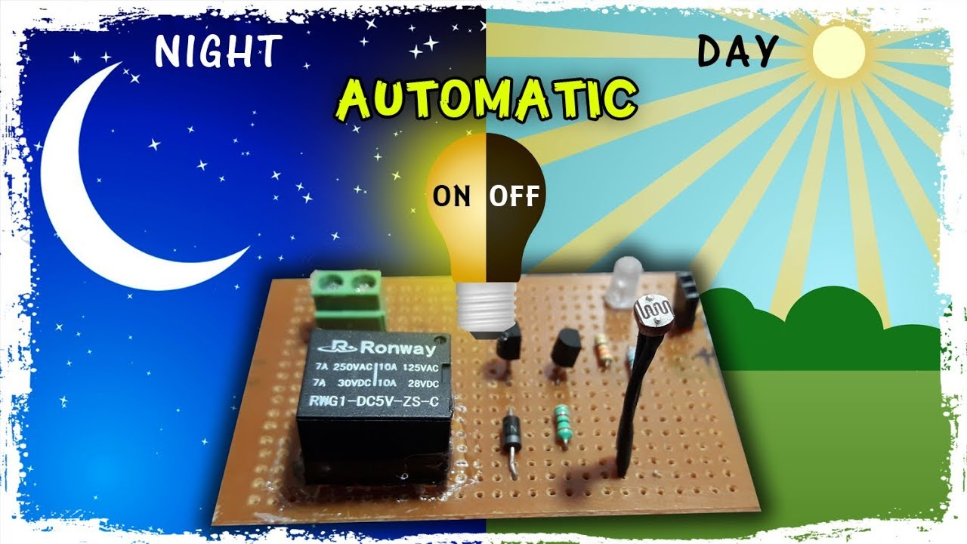
Introduction
This is simple yet powerful concept, which uses
transistor as a switch.
Energy consumption is reduced.
Automatically switches ON lights when the sunlight
goes below the visible region of our eyes.
Automatically switches OFF lights whenever the
sunlight comes and activates the morning alarm.
By using this system manual work could be reduce.
Page – 5

Slide 4
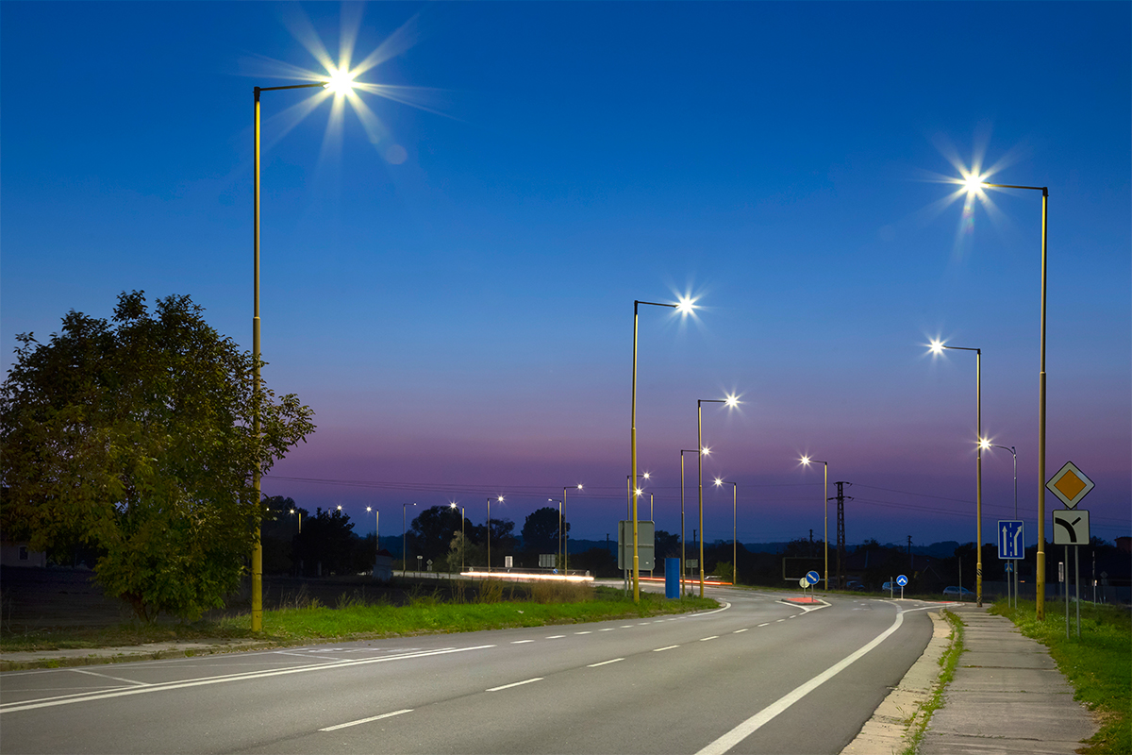
What is Automatic Night Light?
Automatic night lamp as the name suggests is for turning ON and OFF the lamp automatically without the need of human interventions. It senses the light intensity from surrondings and find whether its day or night.
Page – 6

Slide 5

Need of Automatic Night Light
In mining regions people face many difficulties due to absence of light in the nights. In frontier and hilly areas, people face many problems due to damaged street lights. For solving these problems, we create a device in which the lights glow in night and in day time, they get switched off automatically and don't glow. Due to use of it, we can solve above problems and can also save electricity.
Page - 7

Slide 6

Working Method
Page - 8

Slide 7
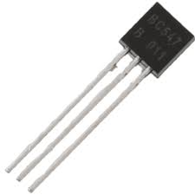
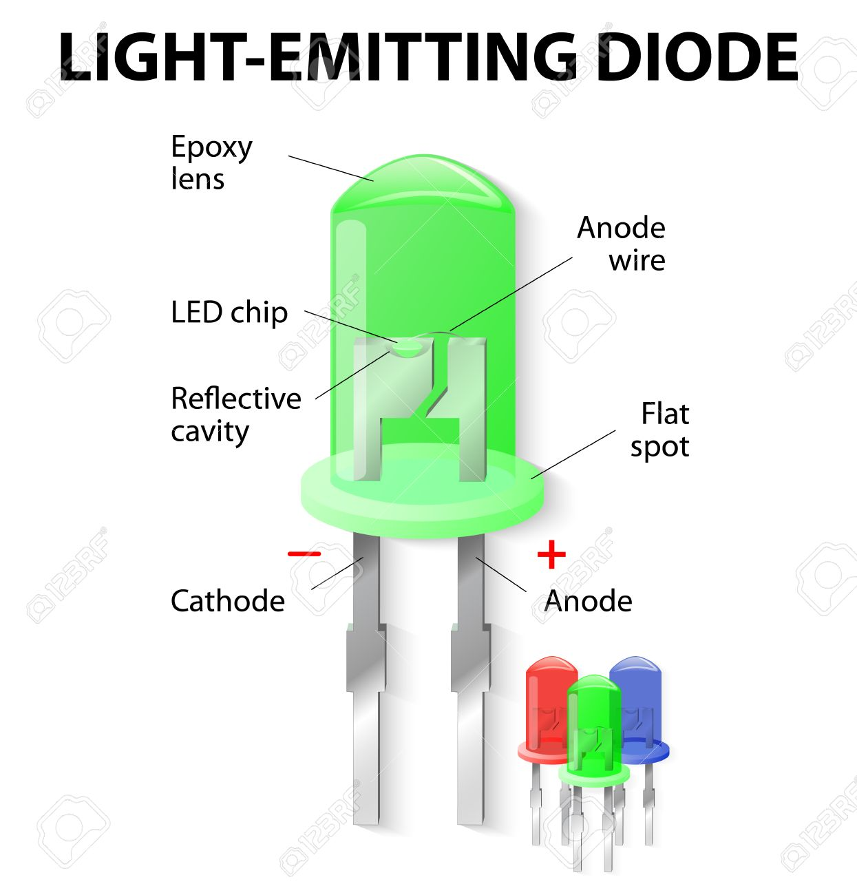
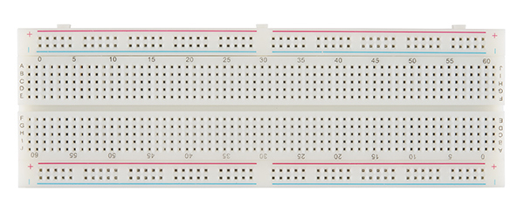
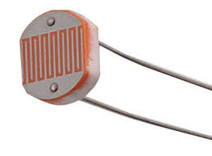
Materials
n-p-n transistor
Breadboard
Resistors:1kΩ, 10kΩ
Connecting Wires
LED
LDR
9V Battery
Page - 9

Slide 8
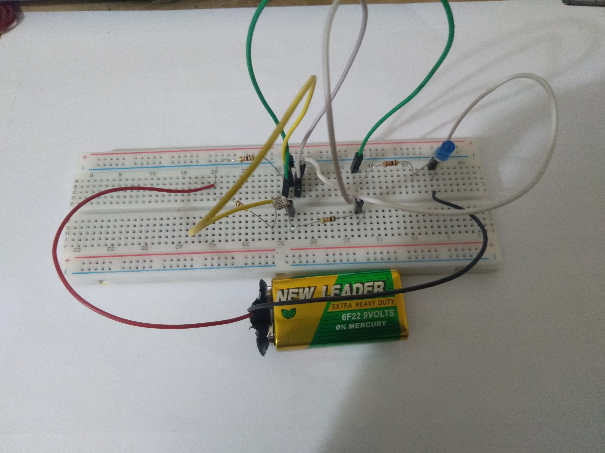
Procedure
Take a breadboard and connect its two halves
Connect a 9V battery on the breadboard.
Connect an NPN transistor on the breadboard with its three legs (Emitter, Base, Collector) inserted in three different columns of the breadboard.
The emitter of the transistor is grounded. Connect one leg of a 10kΩ resistor to the base and other leg connected emitter of the transistor.
Page - 10

Slide 9
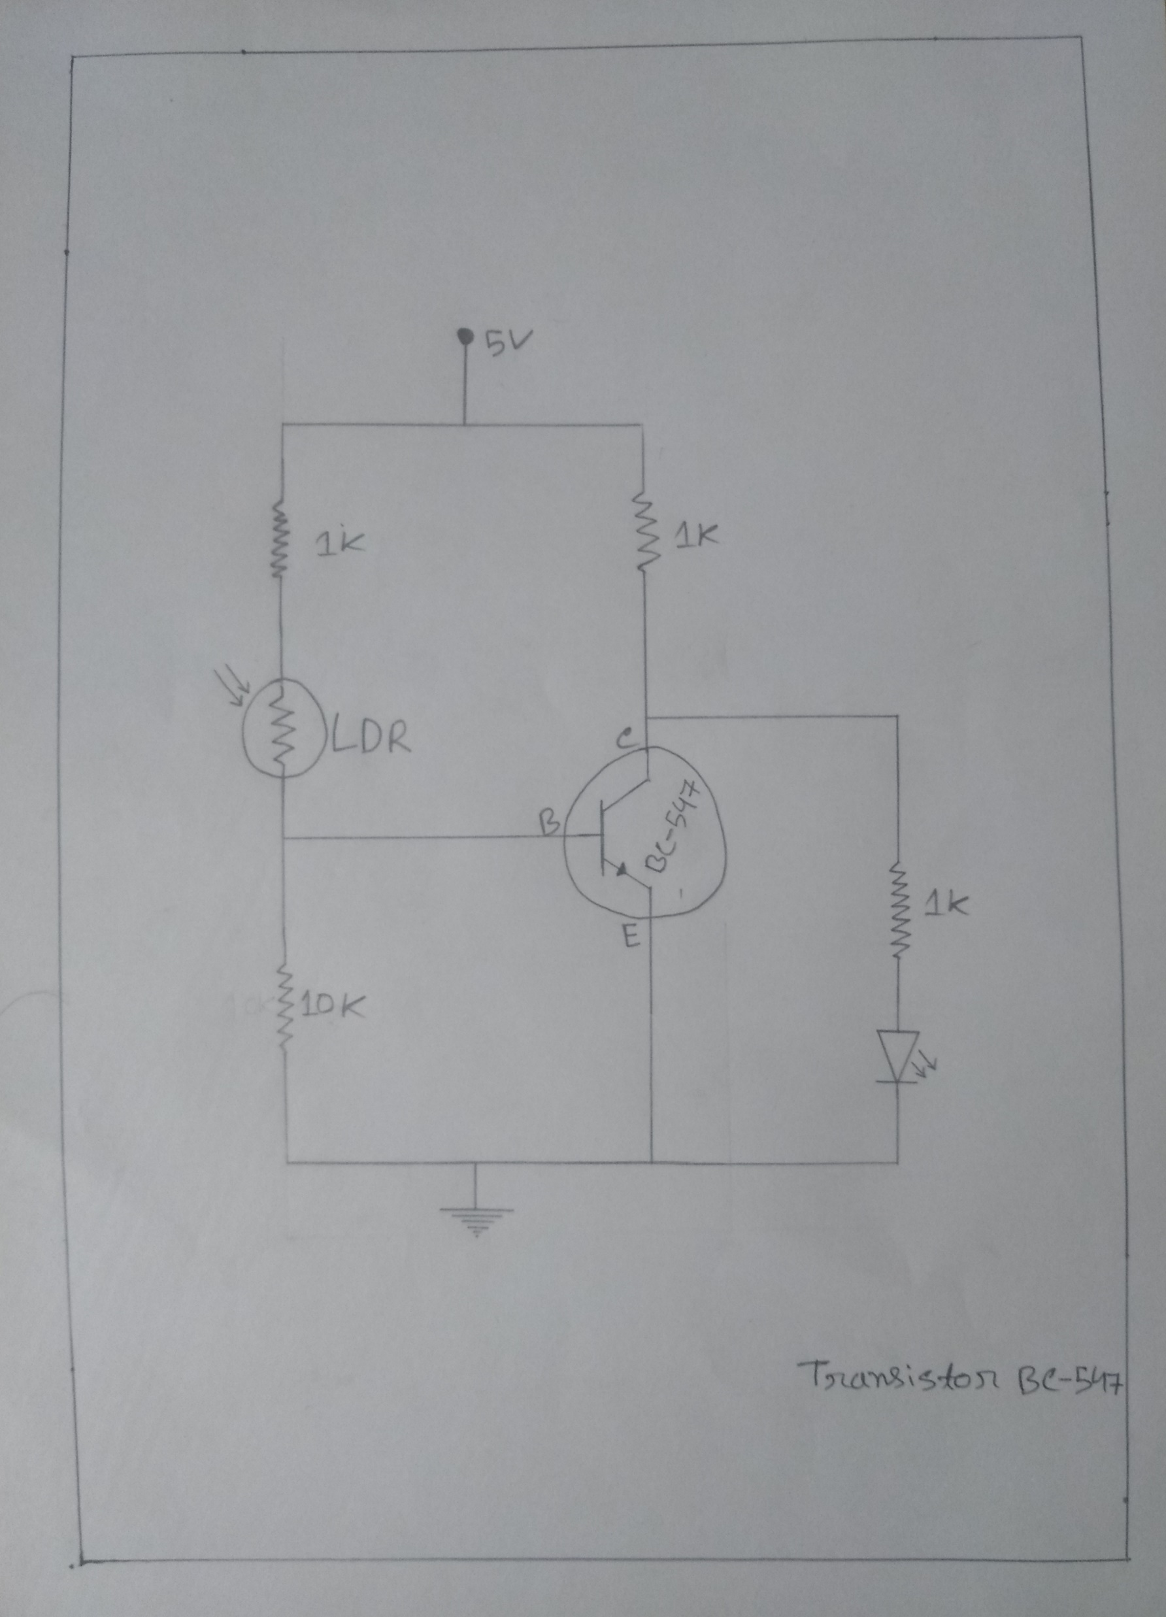
Working Method
Page - 11

Slide 10

Connect an LDR between the base and 1kΩ resistor. Resistor other leg connect Vcc.
The collector of transistor connect 1kΩ resistor and resistor other leg connect Vcc.
Take an LED. Connect its negative terminal emitter of transistor and positive terminal connect 1kΩ resistor. Resistor other leg connect collector.
Page - 12

Slide 11
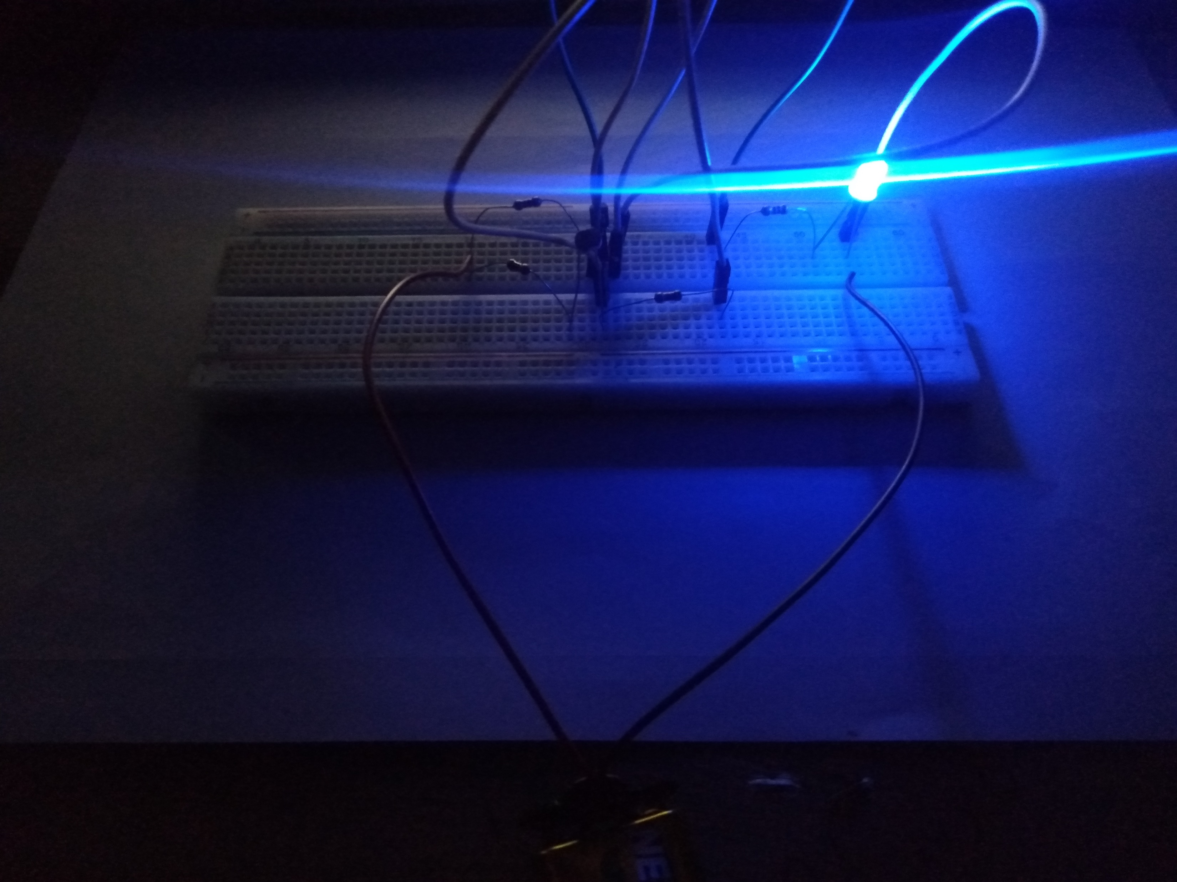
Observation
When the circuit is exposed to light,
The led remains off. When the circuit
is taken into dark, the led glows.
Page - 13

Slide 12
Cost Calculation
Product name | Quantity | Price
Breadboard | 1 | 100
LDR | 1 | 5
n-p-n Transistor | 1 | 4
Battery 9V | 1 | 40
Battery clip | 1 | 12
Resistor 1k, 10k | 4 | 5
Wire |  | 10
LED | 1 | 2
 | Total | =178
Page - 14

Slide 13



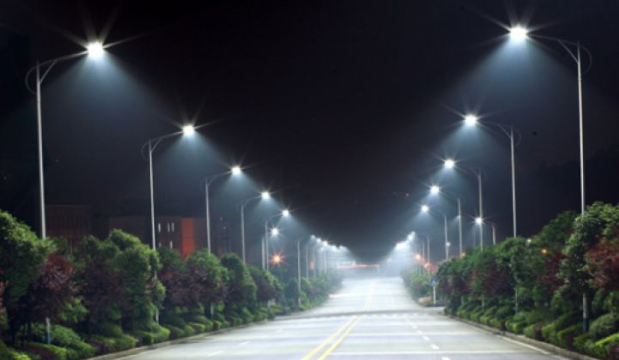
Advantages
Low cost and reliable circuit
When the power goes out in the village, it provides study facilities
Automatic system for street light controlling
Get release of the possibility of theft on dark streets
It can be used as a small light in the room while sleeping
Complete elimination of manpower
System can be switched into manual mode whenever required
Page - 15

Slide 14
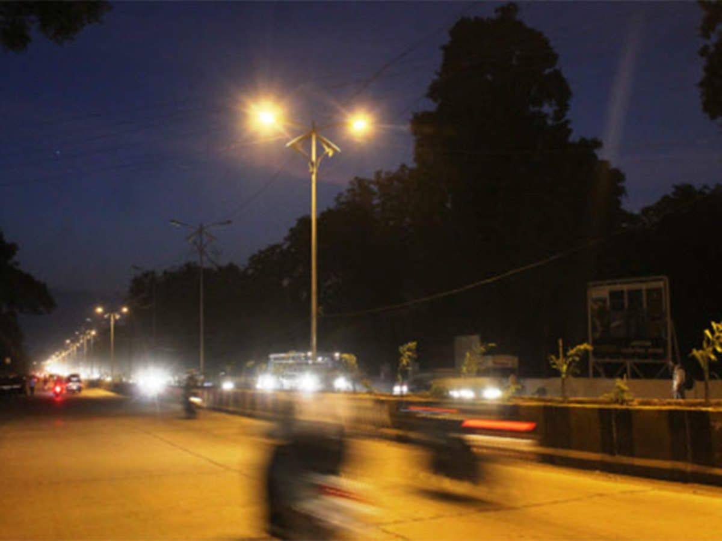
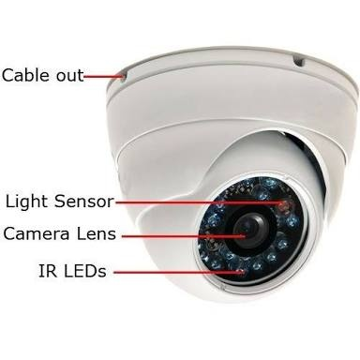
Applications
Road light control
Lamp post
Home Security Light control
CC Camera (Night Mode)
Mobile Phone Tower Signal Light
sleeping time light of room
Page - 16

Slide 15

Limitation
Highly sensitive
Excess current should not be passed through LED
Make all the connections neat, clean and tight
Never exceed the ratings for the current given in the transistor manual
Work according to the light intensity
Page - 17

Slide 16
Conclusion
In coming days, this will prove a great boon to the world, by using automatic night lamp we can save the power because the lights are on when its gets dark otherwise lights are off so there is no power wastage. So it will save a lot of electricity of power plants that gets wasted in illuminating. As the conventional sources are depleting very fast, then it’s tie to think of alternatives. The project Automatic night lamp makes use of a super bright led as the night lamp.
Page - 18

Slide 17



